Slide 1
How to be a misanthrope
Ian James Kidd
University of Nottingham

Slide 2
How to be a misanthrope
Ian James Kidd
University of Nottingham

Slide 3
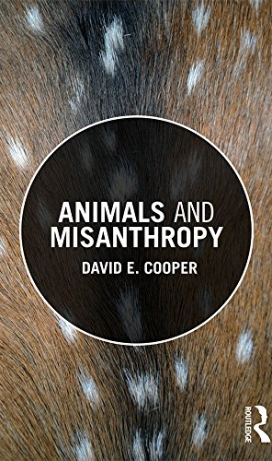
Misanthropy is a negative judgment on the collective moral condition of humankind, as it has come to be.

Slide 4
Failings
diversity, ubiquity, entrenchment

Slide 5
Individuals

Slide 6
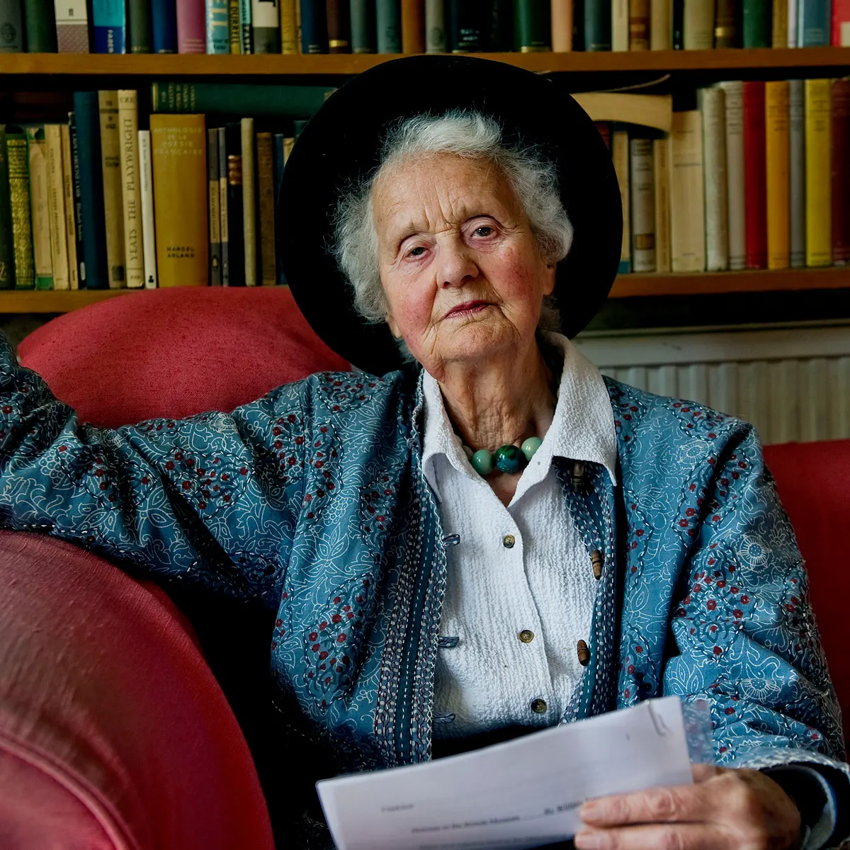
Human nature

Slide 7
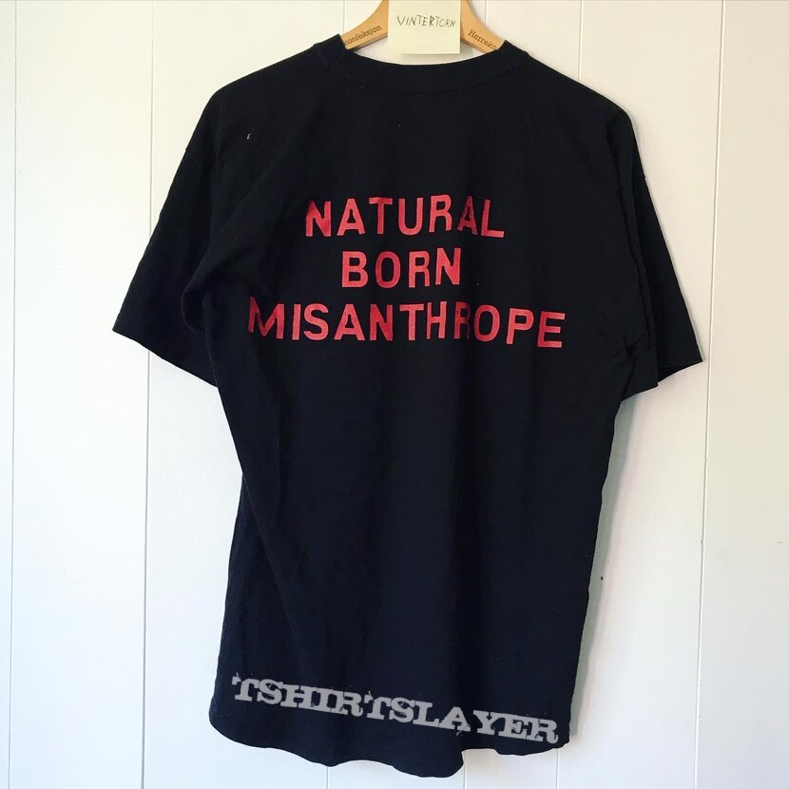
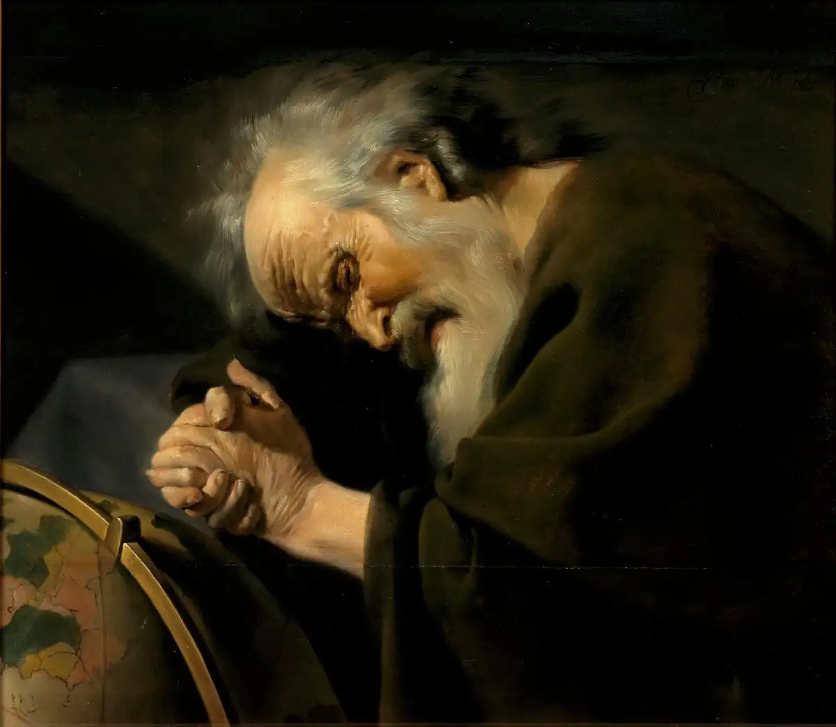
Becoming a misanthrope

Slide 8
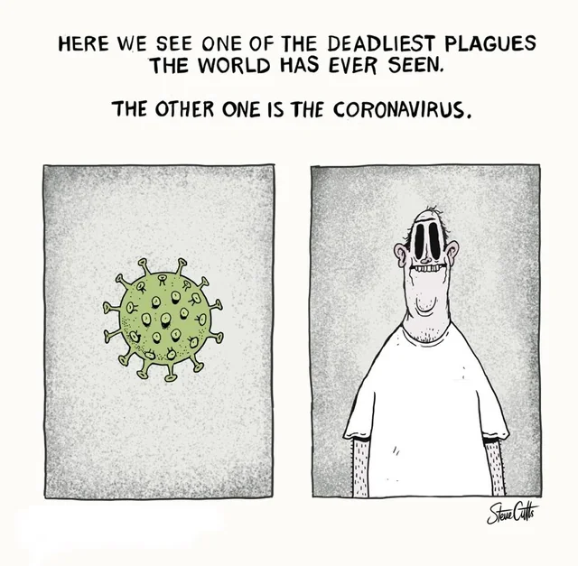
Enemies

Slide 9
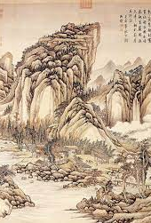
Fugitives

Slide 10
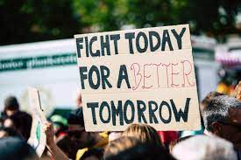
Activists

Slide 11
Quietists

Slide 12
The misanthropic predicament

